Slide 6
Historical data EuroStat

Slide 7
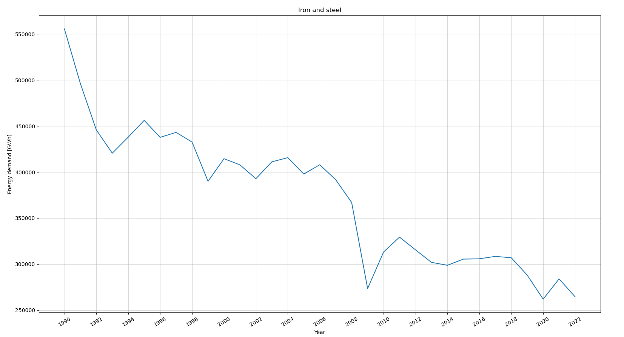

Slide 8
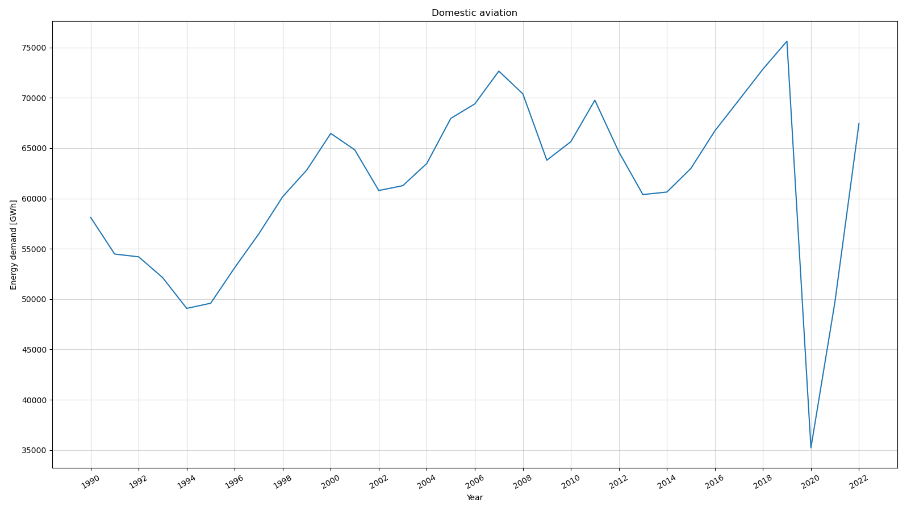
x

